Slide 1
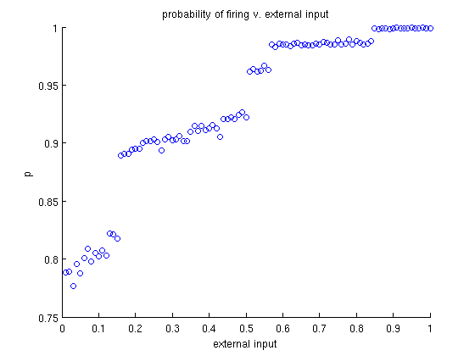


Inference in a Connectionist Model
Kevin Leung, Noah Goodman
Stanford University
Why a different method of inference?
Can we understand this as MCMC?
How well does it perform?
Two popular types of computational models of cognition exist today: connectionist and Bayesian models. Bayesian models treat people as ideal observers who have a probability distribution over hypotheses from observed data. Intended as a computational level description, Bayesian models have been criticized for being not biologically plausible. Connectionist models function at an algorithmic level using neural networks. We hope to implement probabilistic inference over arbitrary distributions in a connectionist framework. This work builds upon other implementations from Jay McClelland and Alexandre Pouget by being fully generative.
a₁^{t}
a₂^{t}
…
a_{n}^{t}
f₁^{t}
f₂^{t}
f_{n}^{t}
a⁰ | a¹
.5578 | .4422
c⁰ | c¹
.235 | .765
b⁰,c⁰ | a⁰ | a¹
From joint | .6773 | .3227
From clamped | .6798 | .3202
From bayes net | .6543 | .3456
Time t
…
A
C
 | b⁰ | b¹
a⁰,c⁰ | .77642 | .223358
a⁰,c¹ | .620722 | .379278
a¹,c⁰ | .517347 | .482653
a¹,c¹ | .226031 | .773969
B
c¹ | a⁰,b⁰ | a¹,b⁰ | a⁰,b¹ | a¹,b¹
From joint | .3414 | .1017 | .2086 | .3482
From clamped | .3179 | .1510 | .2314 | .2997
From bayes net | .3462 | .0999 | .2110 | .3422
a₁^{t+1}
a₂^{t+1}
…
a_{n}^{t+1}
f₁^{t+1}
f₂^{t+1}
f_{n}^{t+1}
Time t+1
…
Corresponding Bayes Net
Conditional probabilities
taking regular samples over time
n continuous variables for activation
n binary variables for firing
non-reversible because of the functions
stationary distribution (if not oscillating)
also has a necessary burn-in time
Why are these networks difficult to learn?
What is the model for inference?
We chose to use an integrate-and-fire activation function for our neural network. In a fully connection network, a unit accumulates activation from the firing of other units until reaching a threshold, when it fires itself and resets
Its own activation. By observing the firing of several units over time, we can construct a probability distribution from those samples.
What are we looking for?
The activation rule is highly non-linear
w_{i1} * f₁
To be useful for inference, this network should be able to generate all conditional probabilities with varying types of evidence. We can simulate the effect of evidence by clamping particular units to values and running the network again. Particularly, we want networks that are “coherent” in that these conditional probabilities from clamping should be correct.
w_{i2} * f₂
Σ
a_{i}
f_{i}
…
w_{in} * f_{n}
The activation function
What’s next?
A
C
A
C
Understand the characteristics of coherent networks
Learn networks for a given distribution
Create larger networks over more variables
Apply it to actual models
B is always firing
B
B
The firing function
p(a=1, c=0)
p(a=1, c=0 | b=1)
should equal
in this network
in this network

